Slide 1
NOISY CHANNEL-STOP AND WAIT ARQ -by Hitesh Nautiyal

Slide 2
Stop-and-Wait Automatic Repeat Request:-
In a noisy communication channel, if a frame is damaged in transit, the receiver hardware will detect this when it computes the checksum.
If a damaged frame is received, it will be discarded and transmitter will retransmit the same frame after receiving a proper acknowledgement.
If the acknowledgement frame gets lost and data link layer on 'A' eventually times out. Not having received an ACK, it assumes that its data frame was lost or damaged and sends the frame containing packet 1 again. This duplicate frame also arrives at data link layer on 'B', thus part of file will be duplicated and protocol is said to be failed.
A typical approach to solve this problem is the provision of a sequence number in the header of the message.
The receiver can then check the sequence number determine if the message is a duplicate since only message is transmitted at any time.
The sending and receiving station needs only 1-bit alternating sequence of '0' or '1' to maintain the relationship of the transmitted message and its ACK/ NAK.
A modulo-2 numbering scheme is used where the frames are alternatively label with '0' or '1' and positive acknowledgements are of the form ACK 0 and ACK 1.

Slide 3
Sequence Number :-
The protocol specifies that frames need to be numbered. This is done by using sequence number. A field is added to the data frame to hold the sequence number of that frame.
The sequence numbers are based on modulo-2 arithmetic.
Stop-and-wait ARQ is the simplest mechanism for error and flow control.

Slide 4
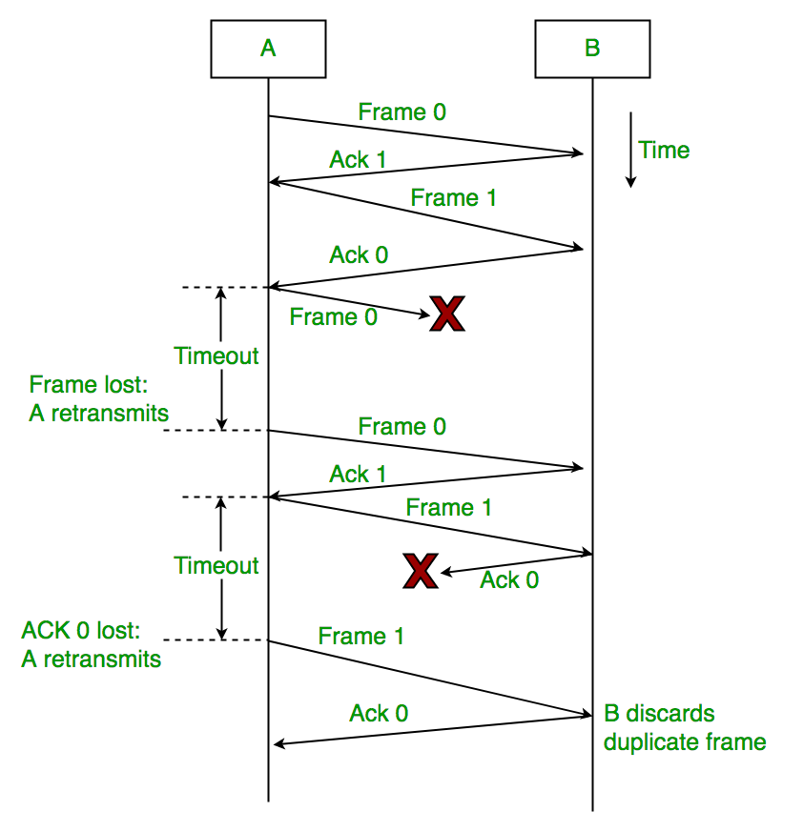
Flow-diagram of Stop-and-Wait ARQ :-

